Slide 1

CP3406
SCENARIO 6:
STUDENT STUDY AND TIME MANAGEMENT APP
PRAC-PART1-B
ZHANG JIALE 14340012

Slide 2
Introduction to the Problem Statement
- Students often face:
• Too many courses
• Part-time job conflicts
• Forgetting assignments & exam dates
- Results: Stress, procrastination, low efficiency
- Solution: App to plan tasks, set goals, and manage study-life balance

Slide 3
Why Important
Time management = success + mental health
Existing tools not tailored for students
I personally face similar issues → Real value

Slide 4
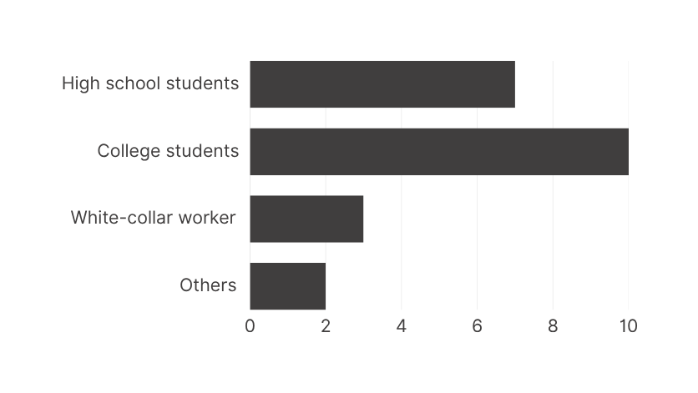
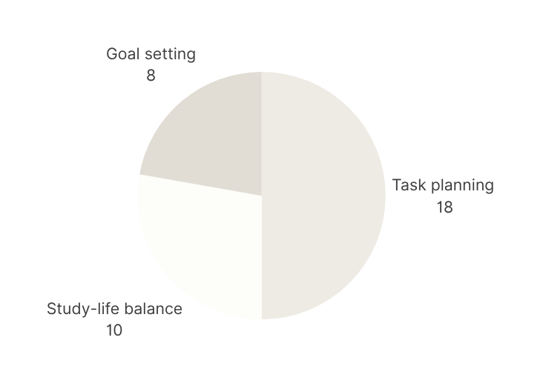
Target Audience
PRIMARY USERS
NEEDS

Slide 5
Competitor Analysis
 | GoodNotes | Google Calendar
Strengths | Clear task management Cross-platform | Cross-platform Strong reminders
Weaknesses | The price is high Handwriting is required | Too general Lacks study goal tracking

Slide 6




Proposed Features
TASK MANAGEMENT
SMART REMINDERS
ASSIGNMENTS, EXAMS, PROJECTS
PRIORITY + DEADLINES
STUDY GOAL SETTING
PROGRESS VISUALIZATION
DAILY/WEEKLY
CHARTS/BARS

Slide 7
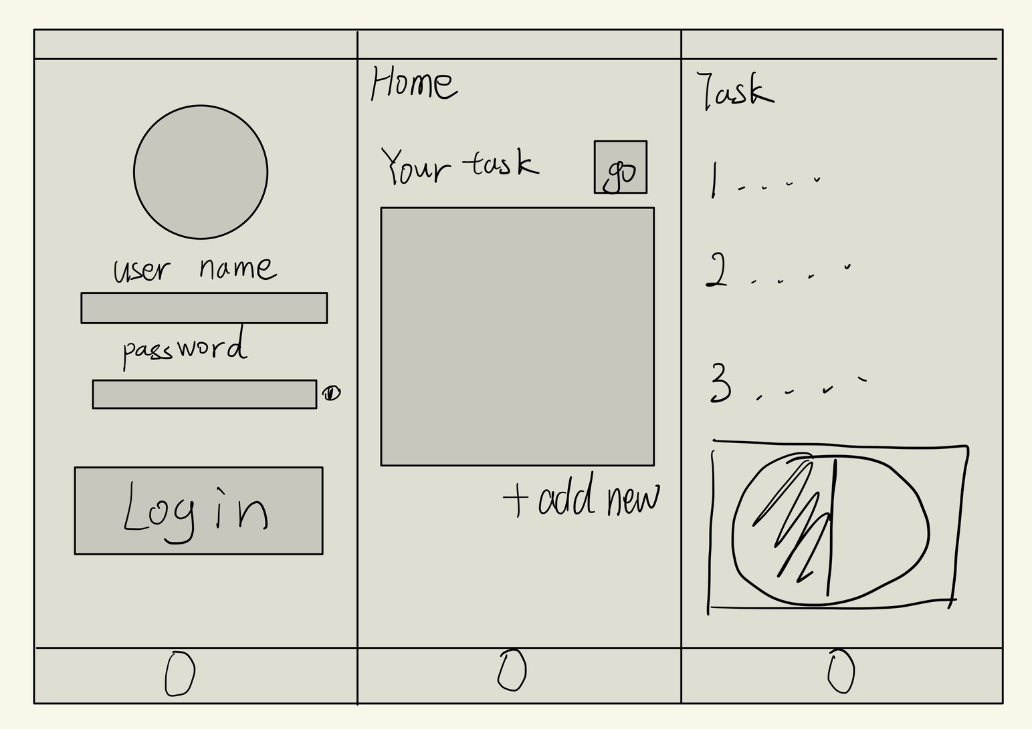
Mockups of Screen Designs

Slide 8
Timeline
Week | Focus Area | Key Deliverable
4 | Setup & Planning | Project initialized, GitHub ready
5 | UI/UX Design | Jetpack Compose UI and navigation
6 | Local Storage | Room database completed
7 | Networking | API integration and sync
8 | Testing | Debugged and tested version
9 | Documentation | README + Promotional video
10 | Submission | Reflection + Final files submission

Slide 9
GitHub Repository & Version Control
REALLYGREATSITE.COM
Repository:
[https://github.com/ZHANGJIALELLLLL/cp3406]
PREPARED BY HARPER RUSSO

Slide 10
THANKYOU

